Slide 1
Sync Study
SyncStudy Team

Slide 2
Content
Background
Pain points
Solution
Implementation
Revenue analysis
Budget, return analysis
Team introduction
Conclusion

Slide 3
background

Slide 4
Background
Entrepreneurship starts in areas of familiarity.
Sync Study:
Start with a more familiar industry: Higher Education
Solve practical problems around every student of XJTLU

Slide 5
Industry pain points

Slide 6


Pain point
The problem is:
University education and corporate demand are NOT closely integrated
Students in general education in the university are NOT fully equipped for the positions required by society.
GAP
The way individuals develop within the school system
The needs of companies

Slide 7
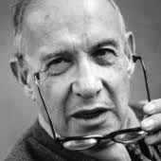
Pain point
Even if you have fully understand and grasped the knowledge you learn from the textbook, you may still find it of extreme difficulty to pass a professional interview
Because there is a lack of professional industry training
"The management challenge
facing humanity in the 21st century is
how to improve the efficiency of
knowledge workers and knowledge organizations" —— Peter Drucker.

Slide 8





Is there no solution now?
Yes,
Linkedin Networking;
Job-hunting APPs;
Lectures organized by Career Development Center;
Professional seminars organized by student clubs;
resources

Slide 9
Is there no solution now?
However,
Almost all existing countermeasures have some disadvantages
1. The information is fragmented and incomplete.
None of these lectures is informative enough
No lectures, no understanding.
2. Lack of methodology
Don't know how to do it
The lecture is very much general, without specific analysis

Slide 10
Solution

Slide 11
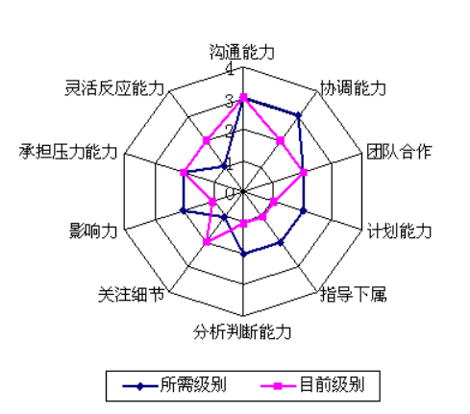
How does your project solve the problem?
This is a platform
Aimed to help students build an ideal model of their personal job-hunting competency.

Slide 12
Diagram representation
System boundaries
Understand required abilities
growth path of students
HR/ Admission officers
Simulation of college life
Students
(users)
Identify ability gaps
Collaboratively enhance students' competence
Identify improvement action plans
Learn from peers
certify qualifications
Teachers/
Institutions

Slide 13
Core flowchart
More mature
young adult
Students begin
System input
Resource provider input
Model update
Enter expected profession, industry and positions
Upload credentials
Preliminary
Career Model
Model Modification
Module of Competency Improvement
College simulation game
Complete tasks
Try again
Select the tasks
College simulation game
Expected position ability dimension
action plans recommendations
Module of Modelling
existing ability dimension comparison

Slide 14
Sounds like a LinkedIn, what's the advantages?
Sync Study
LinkedIn
Based on actual and specific situation of XJTLU, with the aim to serve XJTLUers
Personalized career planning and growth platform
Help students identify, understand, and bridge career development competency gaps
Aligned to the customized training mode for industrial enterprises and Taicang fusion training model put forward by XJTLU
Globalized, too much information
Professional social platform
Most of them cannot be used as reference for our students in XJTLU
Clearly to see other people's resumes
Cannot see the career developement path

Slide 15

Benefits to users(students)?
We've built a long-term ability development platform
conducive to helping students develop the habit of continuous learning
help students NOT to WASTE their valuable time
A Navigational Compass that makes users better
Where you are?
where you have gone?
What you have done?
Where you should go?

Slide 16
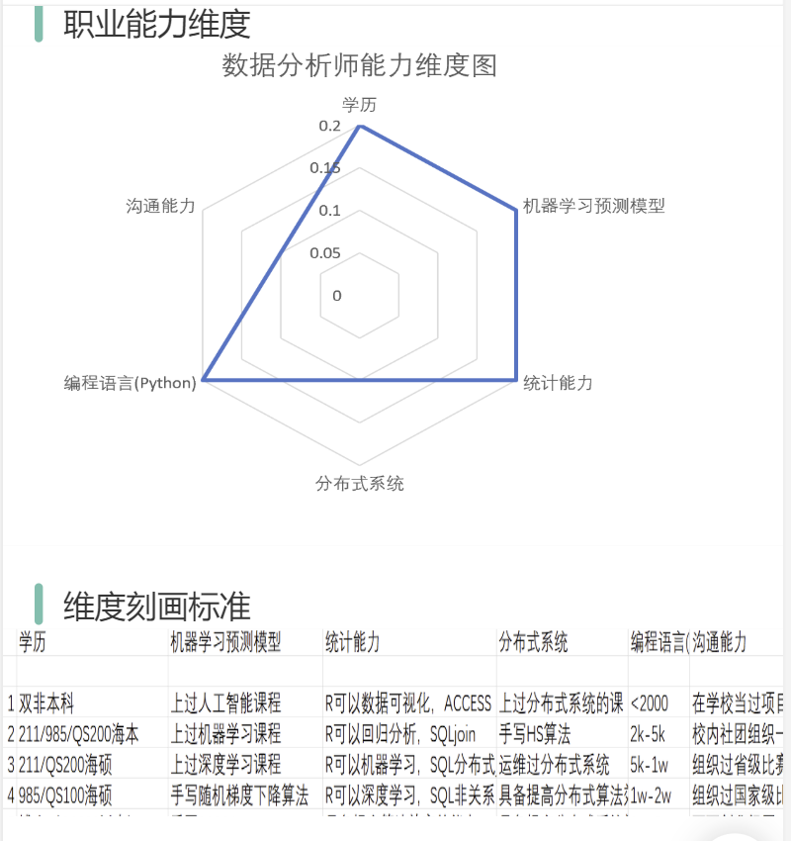
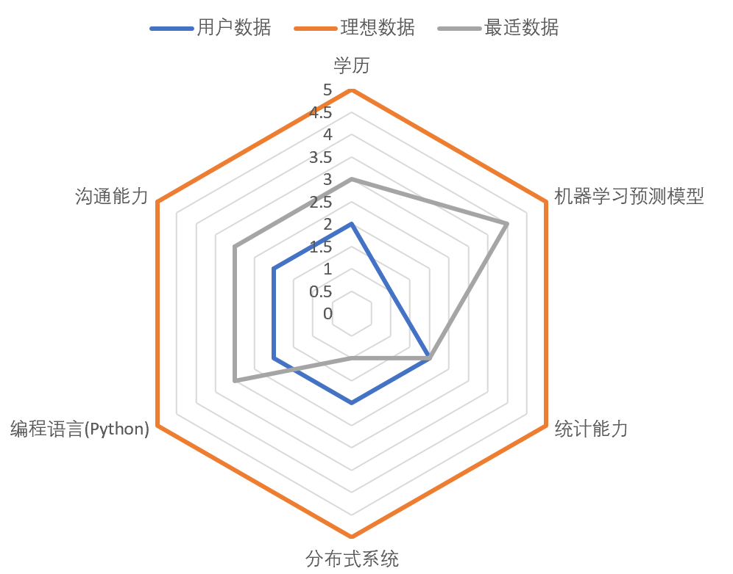
Benefits to users(students)? - continued
Become a source of self-identity other than approval of your parents and teachers
a dynamic monitor on the process of personal competence development
Help fully utilize opportunities and resources at XJTLU
XJTLU has offered lots of learning resources on not only academic development, but also your postgraduate application and career development
However, the majority of our students can NOT take the best advantages of those resources

Slide 17
What makes the difference?
Student A
Student B
Top 3 student
Volunteer Academy
Peer Teaching Club
Result:
A paid internship
Top 3 student
Stanford Session waived TOEFL
10 patents of invention
SURF with conference pre
MCM 1st prize
Entrepreneurial Practices
ILEAD research-led competition
Blockchain application competition top1
Result:
Pass interviews and goes to an ideal iposition

Slide 18
How do you embody artificial intelligence?
Artificial intelligence is mainly embodied in modeling.
First, human ability topology analysis:
fuzzy comprehensive evaluation of the individual's ability to model, build the ability of the topological structure map (mainly for enterprise positions with clear needs).
Second, machine learning analysis:
use a sufficient number of previously accepted student portraits, do clustering analysis, machine learning, to find the characteristic values of the decision admission (after we collect enough multi-dimensional labels to design a feedback system, optimize the model).

Slide 19
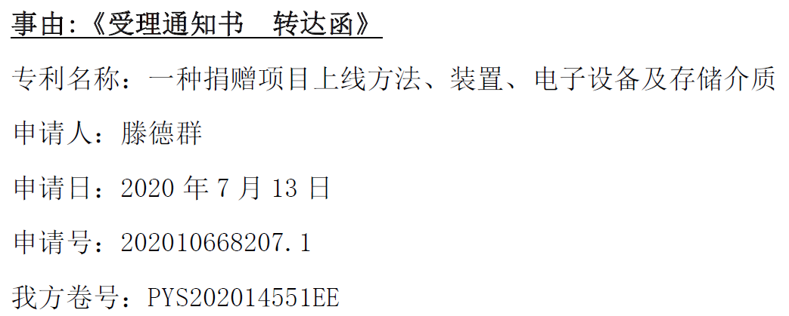

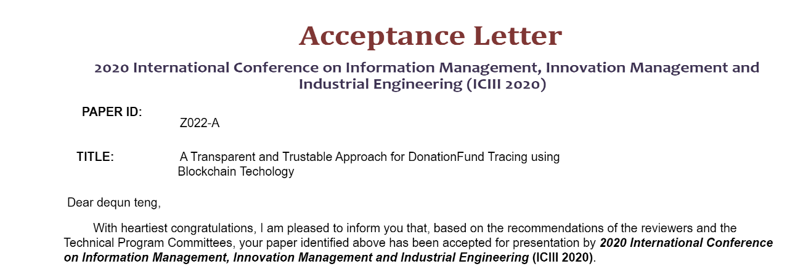
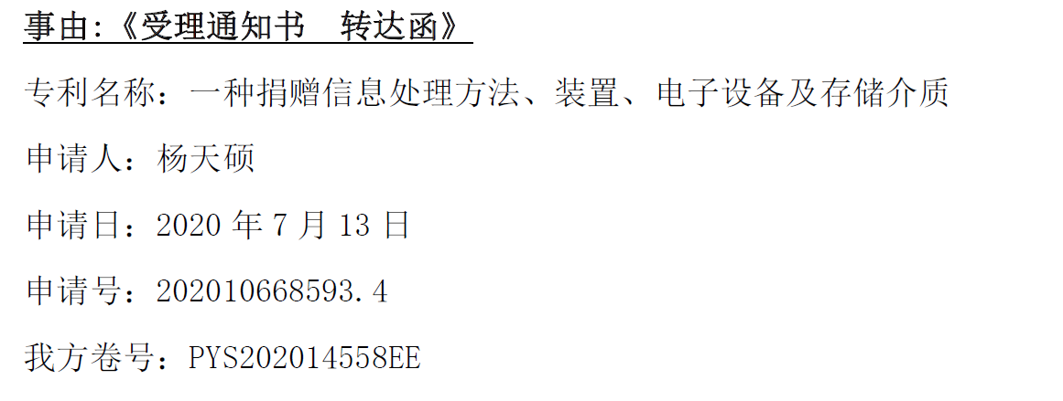
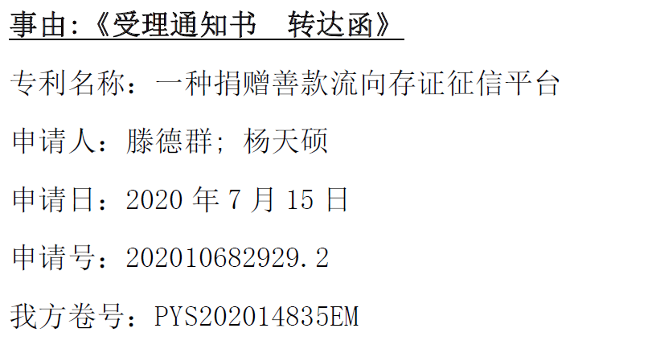
Intellectual property protection
The team has accumulated 10 distinctive patents in total
2 patents are under substantive examinations.
1 patent was filed for intellectual property protection
Accepted by 2020 Osaka International Information Management Conference on Innovation Management and Industrial Engineering.

Slide 20
Revenue analysis

Slide 21
Revenue analysis
APP：To B
APP：
To C
82%
14%
Revenue from APP
Revenue from APP
Cooperation with Education institutions
Cooperation with career consulting firm
Form of revenue：
Advertising
Commission fee
APP users' purchase of personal career planning report
APP users' purchase of job details
APP users' purchase of internal promotion planning projects in the enterprise
GAME

Slide 22
Revenue analysis

Slide 23
budget, Financing plan, return analysis

Slide 24
Budget
Marketing Department
Department of Human Resource
Technology Department
Note：the first years' expenses is Logistics Department is zero.

Slide 25
Return analysis

Slide 26
Team introduction

Slide 27
Our start-up team
Student of Instructional Technology and Media, Columbia University
Student of Innovation and Entrepreneurship, University of London
A startup founder who manages more than 30 people
Jiangsu Merit Student, National Scholarship, Liverpool Admission Scholarship, Academic Excellence Scholarship, Meritorious Winners of Mathematical Contest in Modeling.
Third Prize in Enactus World Cup China Division, National Top 16 in PWC enterprise innovation CSR, the Second Prize in SSC CHINA.
Technical group per capita apply for 7 invention patents, with mini program building experience and web page building experience.
Three students' stories have been posted in the Public account of XJTLU

Slide 28
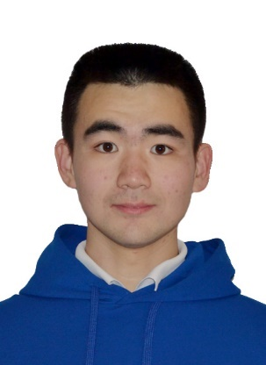
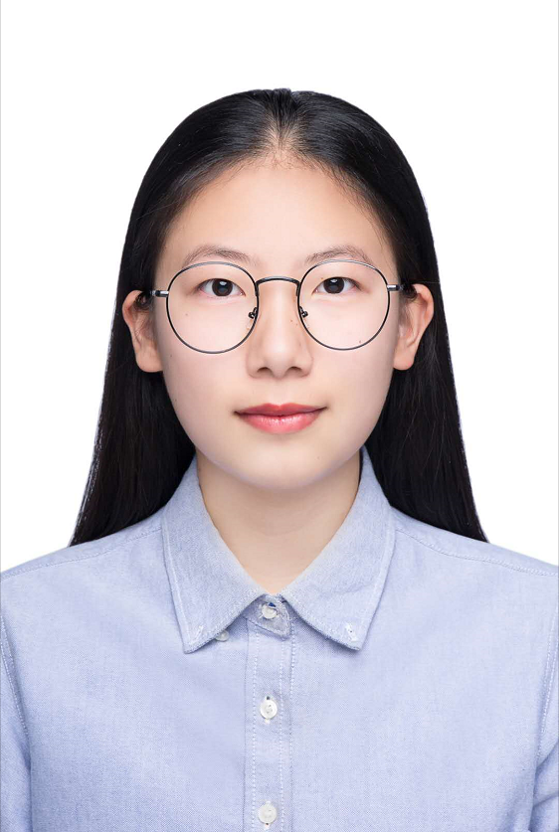
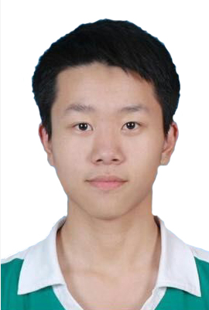
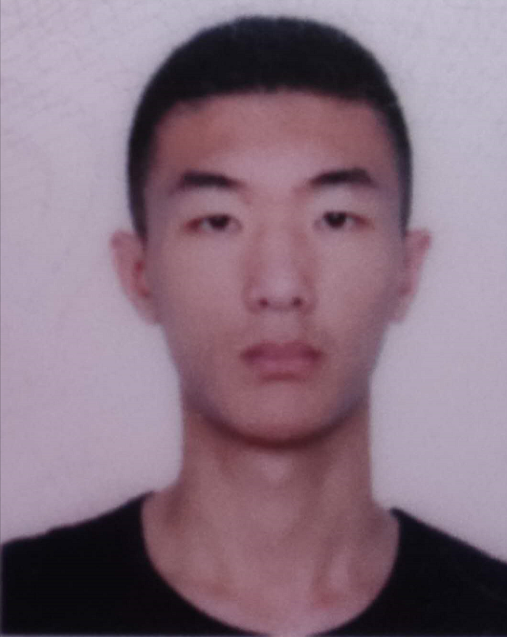
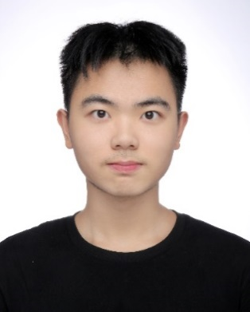
Introduction to team members - Technical Group
Dequn Teng
Jia Zhang
Juncheng Liu
Tianshuo Yang
Chengrui Zhang
Person in Charge
Product
UI
Backend
Model
Stanford AI and Algorithm Session Scholarship for Academic ExcellencE XJTLU ,5%; 7 patents for inventions.
Task：UI，use case diagram
Ability：Java, C++，Adobe Premiere, Photoshop, Design，Paint
Task：Website UI design
Ability：Java, C++, Python, Adobe Premiere, Photoshop, UI，coding，filming editing
Java, Python, php，linux，thinkphp，vue,
XJTLU blockchain application top 1，Humanity and technology award
Liangu Blockchain application and innovation award（4％）
java, C++, mysql, mongodb, linux, Rust, node.js,
2019 SURF Visual Track

Slide 29
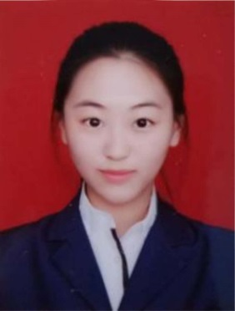
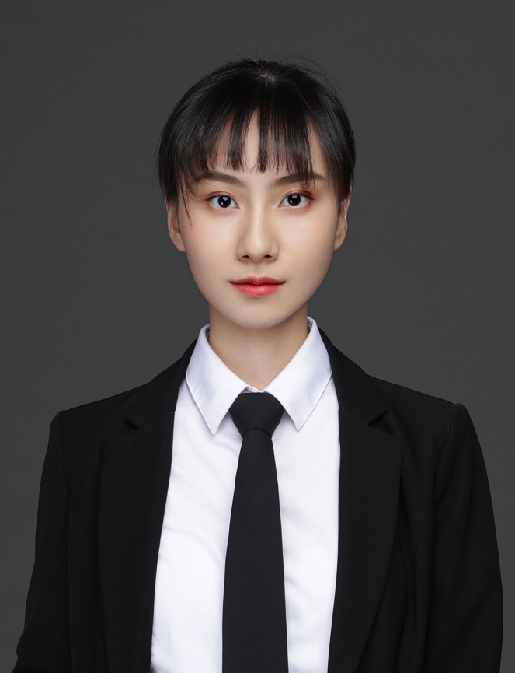
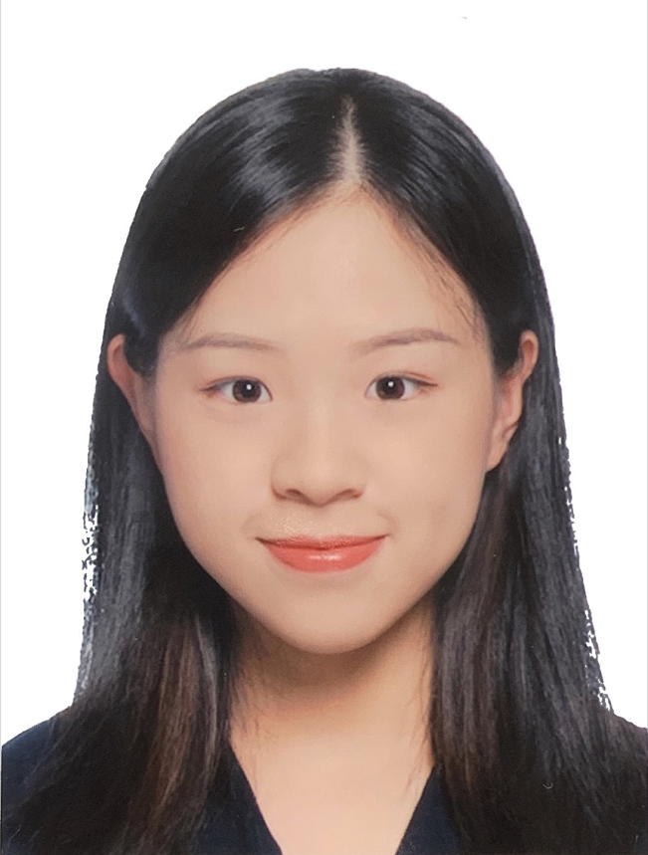
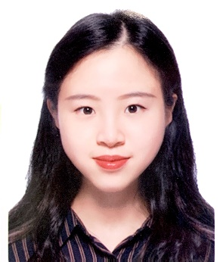
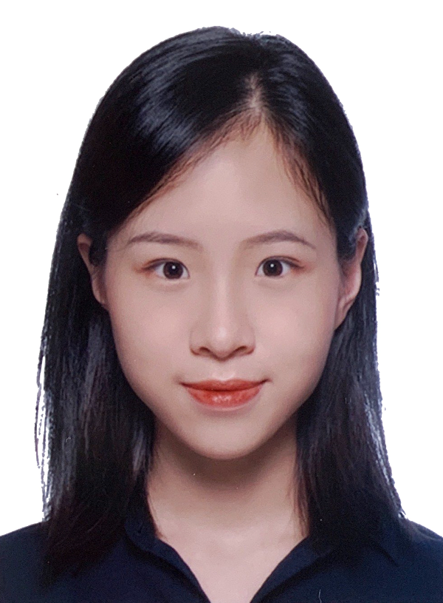
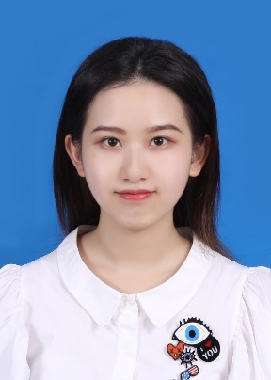
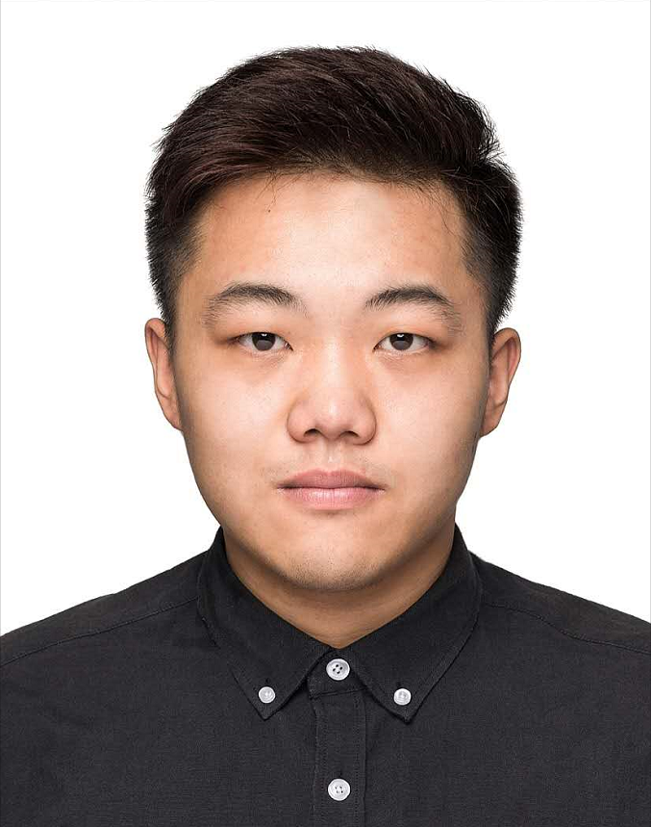
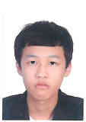
Introduction to team members - Business Group
Zhili Zhao
Yajing Liu
Huating Wu
Huayan Wu
Huazhan Wu
Person in Charge
Market
Market
Market
Market
Company management experience of 30 people，capable with communication ability；
Innovation and competition Third prize
UCL Entrepreneurship
Sino-Us Creativity Competition Second prize；BM business group top 3；data analysis competition top 3
Proficient in Google Analytic, SQL, SPSS
Marketing P&G 2020 CEO challenge，Shanghai STP talents program；XJTLU academic excellence scholarship （1%)
Proficient in GA, Adobe Photoshop, SPSS；
C3 creativity challenge top 1，2019Ｑ1 world cafe exchange table competition excellent prize
Proficient in GA, Adobe Photoshop, SPSS；Procient is preparing PPT, Business Plan
Zhaolu Zhang
Shengyi Ding
Yizhang Gong
Accounting
Accounting
Accounting
Columbia University Instructional Technology
XJTLU best performance in FYP
MCM M prize eco campus research evaluation contest International Sillian Valley Third Prize
ACCA 8； two SURF projects
ACCA5 subject ；XJTLU charity club first hand；XJTLU ；
Business Model Experience
Pass ACCA 6；Proficient in PPT design, Excel, Sage
PWC you plus
Project

Slide 30
Conclusion

Slide 31

Finally, I want to say
We firmly believe that the integrated education concept of XJTLU is more suitable for the development of contemporary college students and our team is willing to make a contribution!
Everything is ready to go!

Slide 32
We really need the help of Angel Funds and guidance of your expert judges’! Thank you
Sync Study Team

